Slide 1
Comparison of multimodal analgesia with thoracic epidural after transthoracic oesophagectomy
Jordan Ng Cheong Chung, S K Kamarajah, A A Mohammed, R C F Sinclair, D Saunders, M Navidi, A Immanuel, A W Phillips
Northern Oesophagogastric Unit, Royal Victoria Infirmary, Newcastle upon Tyne, UK.
Department of Anaesthesia and Critical Care Medicine, Royal Victoria Infirmary, Newcastle upon Tyne, UK.

Slide 2
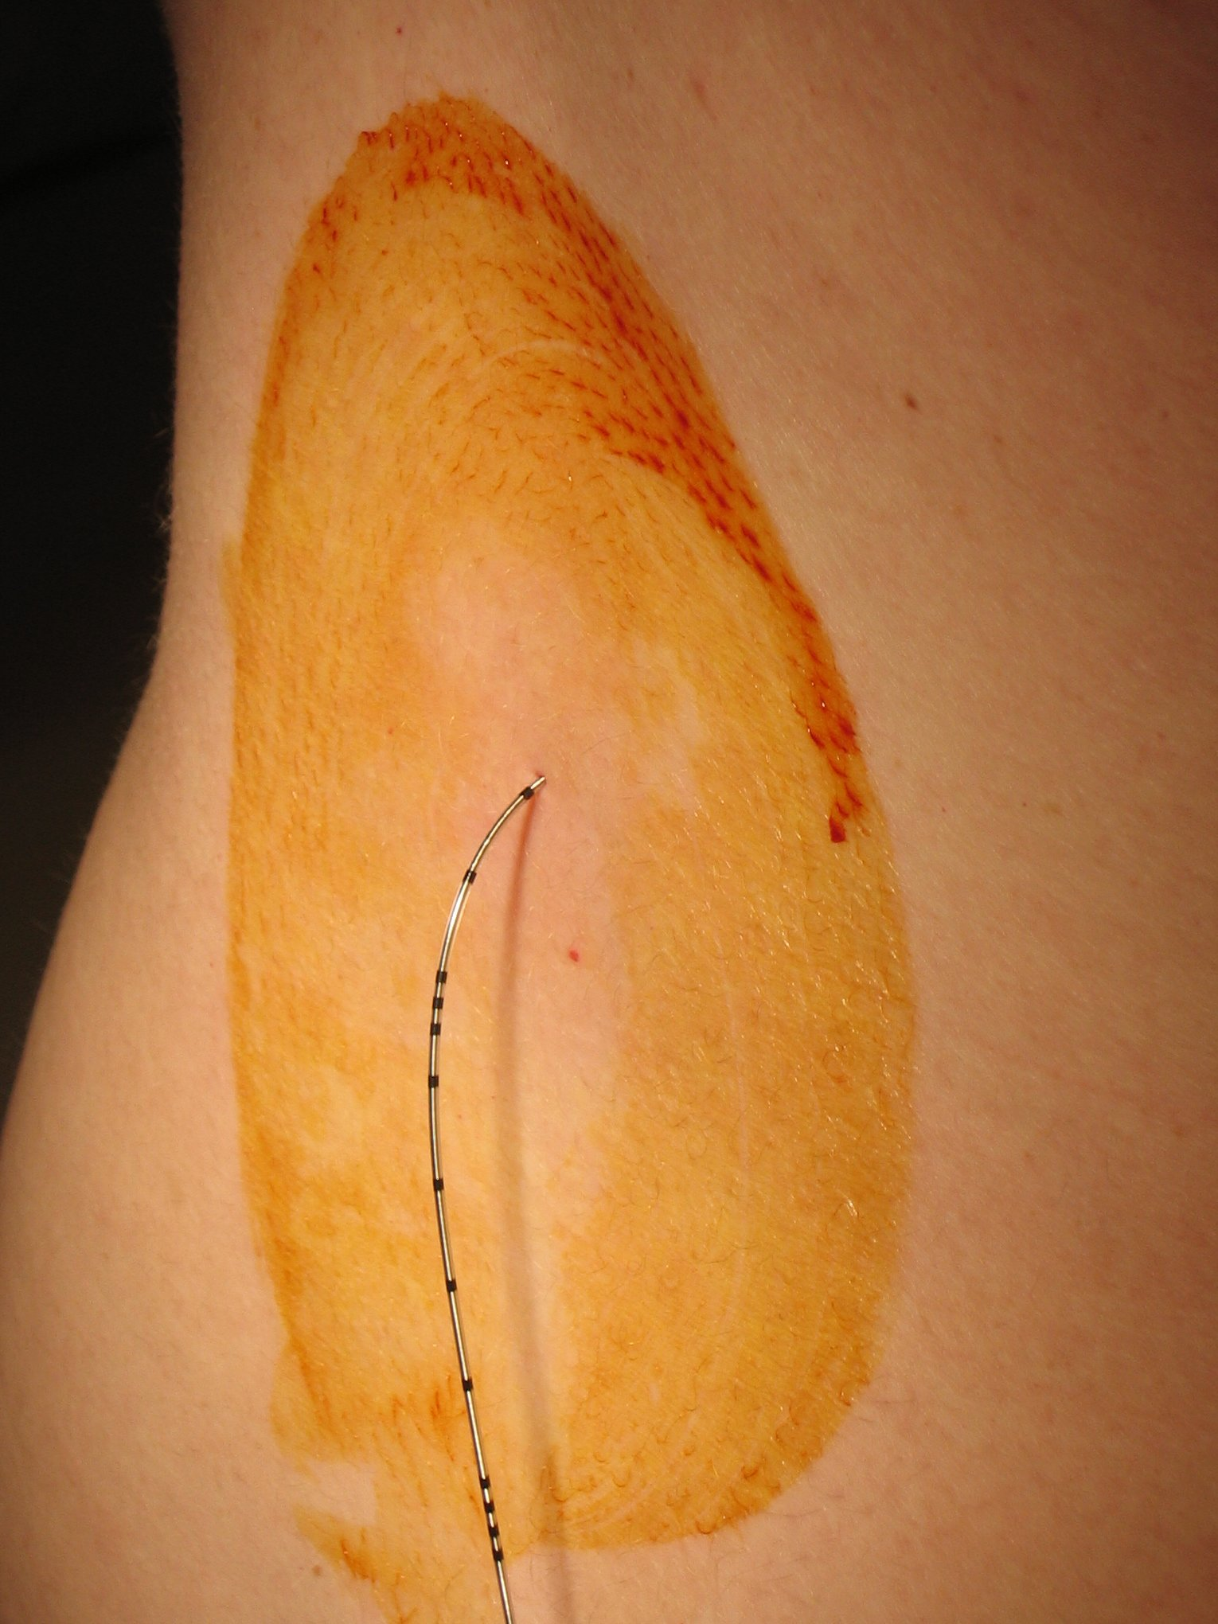
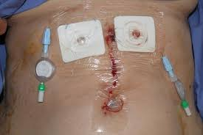
introduction
Thoracic epidural analgesia (TEA)
Gold standard
Excellent pain control
Few postoperative complications
Impair mobilisation due to postural hypotension
Multimodal analgesia (MA)
Non-inferiority in major surgery
Facilitate mobilisation
Limited evidence in oesophagectomy
Comparable analgesia
Aim of this study: To determine whether MA provided clinically comparable analgesia to TEA following transthoracic oesophagectomy

Slide 3
methods
Vs.
January 2015 to December 2018
Epidural or Multimodal analgesia
Pain scores and episodes of hypotension
Data collection including demographics, analgesia regimen, pain scores, hypotension, vasopressor use and complications
Primary outcome: Pain scores on postoperative days 0 to 3
Secondary outcomes: Episodes of hypotension (SBP<90), vasopressor use and complications on the Clavien Dindo classification
Statistical analysis: Propensity score matching using variables age, sex, neoadjuvant therapy, ASA grade, and thoracic surgical access. Matched using 1-to-1 nearest-neighbour propensity score matching (PSM) without replacement.

Slide 4
results
Patients identified undergoing oesophagectomy (n=293)
Thoracic epidual analgesia (n=142)
Multimodal analgesia (n=151)
Propensity score matching (1:1)
Thoracic epidural analgesia (n=100)
Multimodal analgesia (n=100)

Slide 5
Baseline characteristics

Slide 6
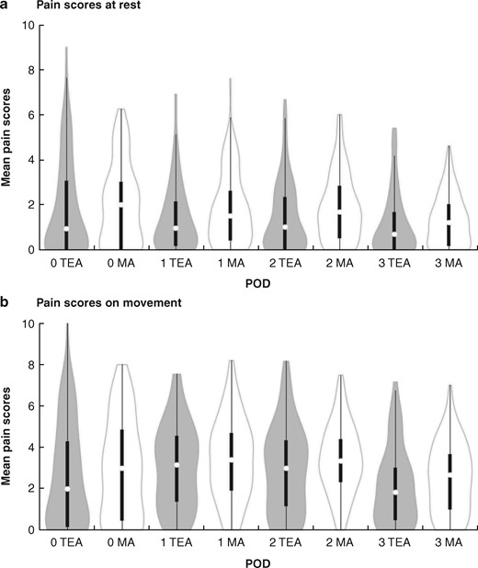
PAIN SCORES
*
*
*
* = statistically significant
*

Slide 7
SECONdary outcomes

Slide 8
discussion
Low pain scores for both TEA and MA
Statistical significance does not necessarily mean clinical superiority
Previous studies have suggested that, for a visual analogue scale, a difference of 0.9–1.6 cm is clinically significant (0-0.8 in this study)
Significantly fewer episodes of hypotension and vasopressor use in MA cohort with no notable postoperative complications

Slide 9
limitations
Single centre experience
Hypotensive but fluid responsive patients
Total opioid consumption

Slide 10
conclusion
Comparable analgesia between TEA and MA after oesophagectomy
Fewer patients in MA cohort had episodes of hypotension and vasopressor use
No difference in postoperative complications
Multimodal analgesia is a suitable alternative to thoracic epidural analgesia and could be the standard of care

Slide 11
Thank you

